Slide 1
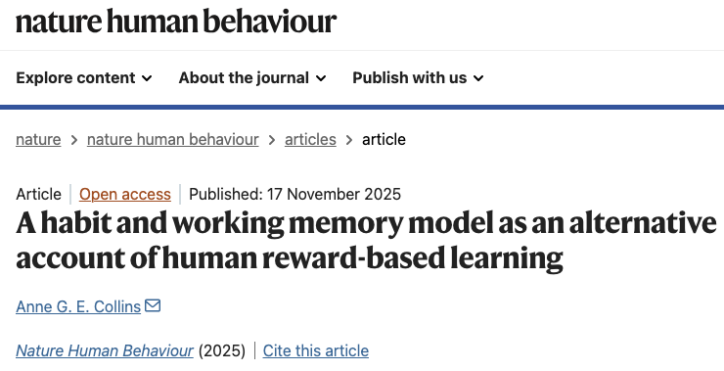
Zihan Bai
IDEM Lab Meeting, 11/21/25

Slide 2


Slide 3
Human performance (instrumental learning) is not supported by reinforcement learning (RL) computations.
Instead, it is driven by a fast working memory (WM) and a slow habit (H) system.
Central Claim

Slide 4
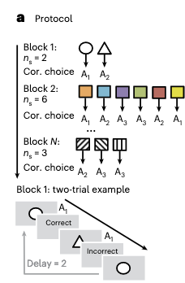
RLWM Task
Disentangle WM contributions from those of slower, iterative RL process to reward-based learning by manipulating information load

Slide 5
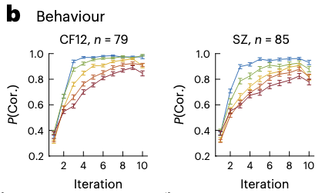
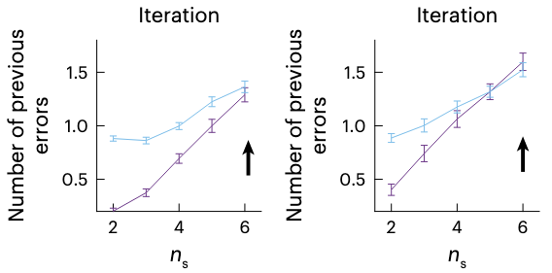
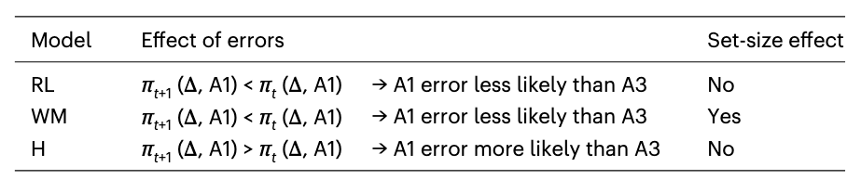
Natural human learning patterns across multiple datasets
What RL assumes
What the actual behavior is
What this implies
People should continuously update the value of their choices by learning from mistakes (negative feedback).
So they should rarely repeat the same mistake twice, and should learn 6 items as effectively as 3 (no set-size effect)
Small sets (n= 2, 3): near perfect performance
Large sets (n= 6): performance drops significantly
When overloaded, they stop caring about correct vs. incorrect. They just repeat whatever they pressed last time, even if it was a mistake - proof of brain isn’t calculating value (RL, it’s just building a habit)
A resource-limited process, working memory, is the primary indicator of learning, not reward value integration

Slide 6
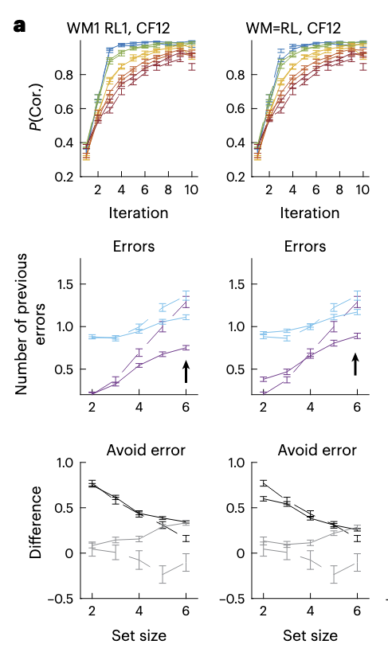
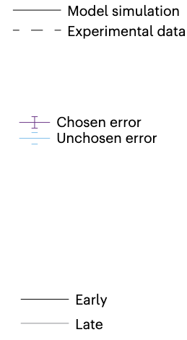
A standard RL model cannot reproduce human behavior in this task
Even if the task is hard (n=6), RL models still learn from mistakes, indicated by a non-zero difference between the number of chosen and unchosen errors
Why: RL algorithm is mathematically forced to update value when it gets an error - can’t ignore a zero
(contrary to what was observed empirically!)
They tried to make the RL model work. They even modified it to completely ignore negative feedback (setting the negative learning rate to zero). It still failed. The model predicted that WM would effectively guide us to avoid errors, even at high set sizes. But the human data showed that people do not avoid errors when overloaded.
This implies that the slow learning process isn't just "failing to learn" from errors; it is actively working against the correct choice.

Slide 7
What is the solution that explains human learning when overloaded?

Slide 8
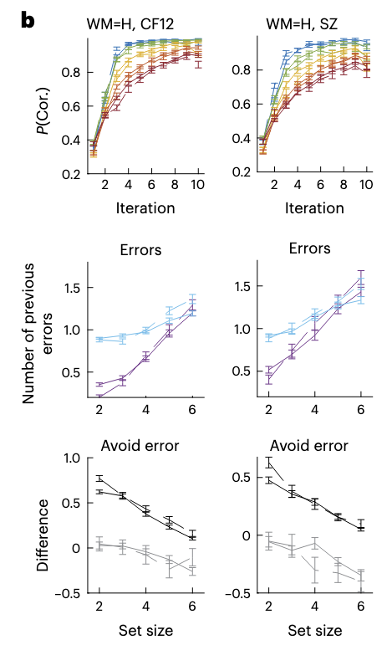
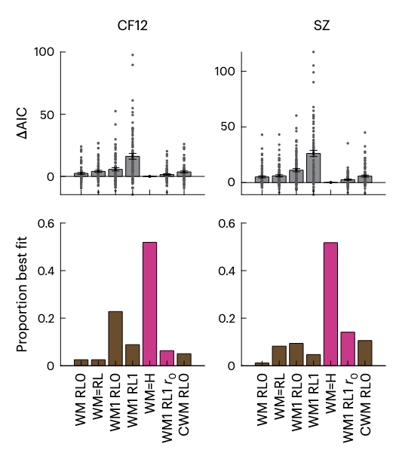
A new WM-H model fits the data
Introduce a habit (H) agent, where value of both reward and mistake is the same (r = 1)
It tracks frequency of choice, but not value, regardless of outcomes
WMH is the best fit across all datasets
WMH reproduces natural human learning

Slide 9
WMH model works for tasks where the answer is always 100% correct
But RL is specifically designed for probabilistic environments
(e.g., correct = 80% reward)
Does this model still work?

Slide 10
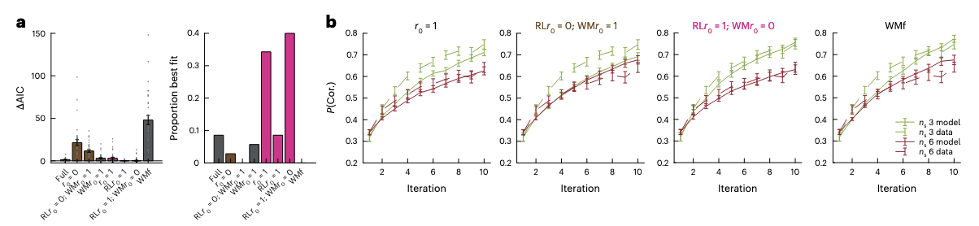
WM-H also fits the data in a probabilistic task

Slide 11
But if habit system is this rigid that it ignores outcomes,
how do human actually learn anything at all?

Slide 12
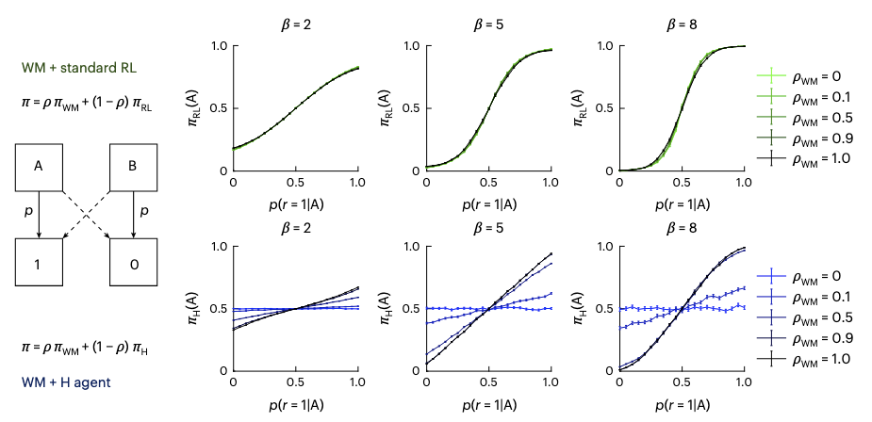
H agents learn to mimic RL when WM contributes enough to choices

Slide 13
Q & A

